Slide 1

Introduction to Deep Learning
With Ahad Jawaid

Slide 2
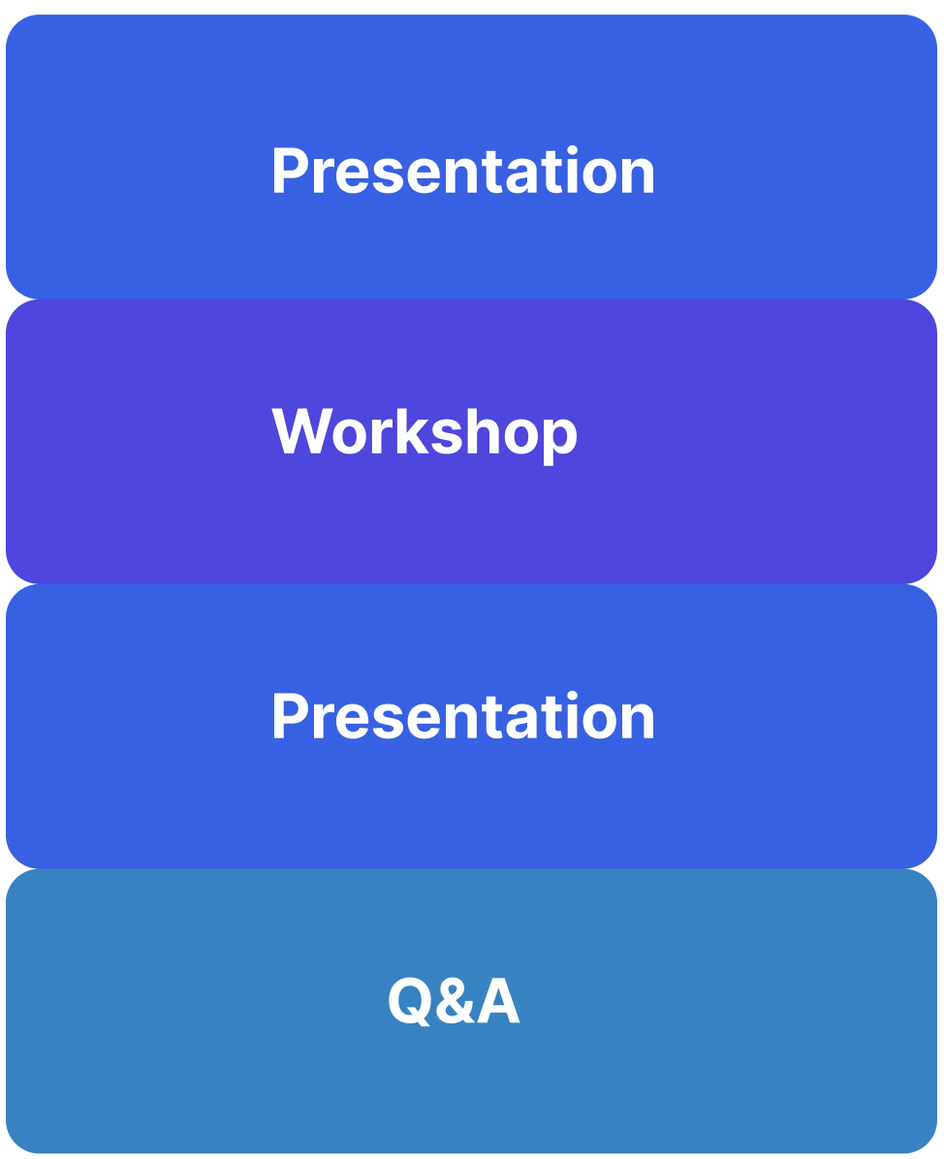
Overview

Slide 3

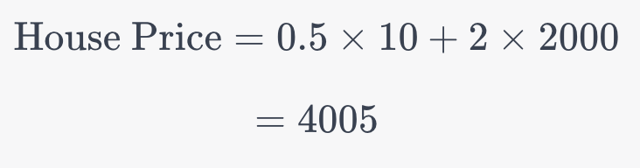
Weighted function

Slide 4
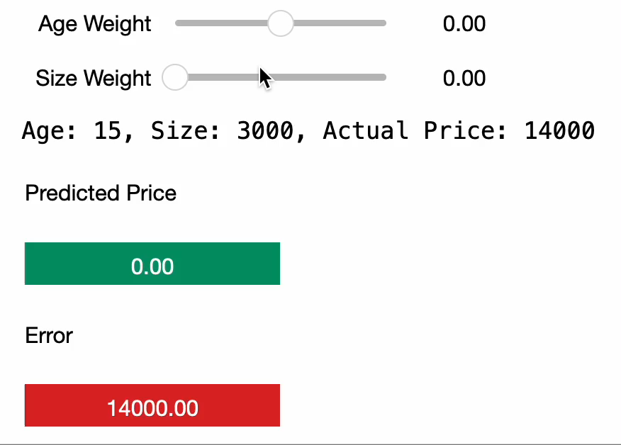
Picking parameters

Slide 5
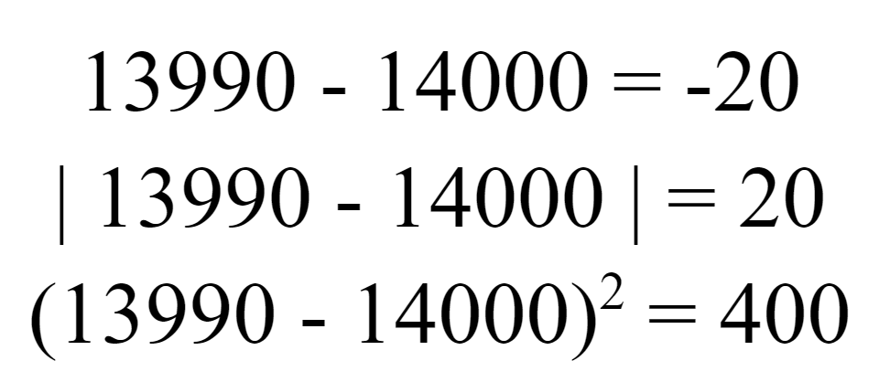
Measurement of Error

Slide 6
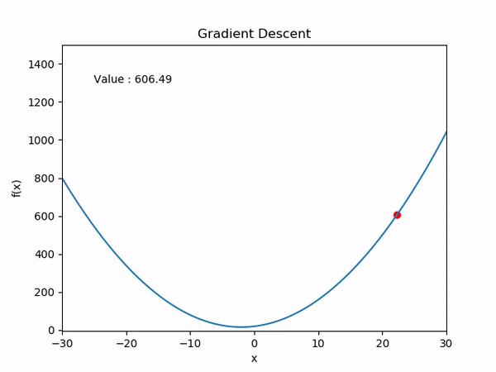
Automating picking parameters

Slide 7
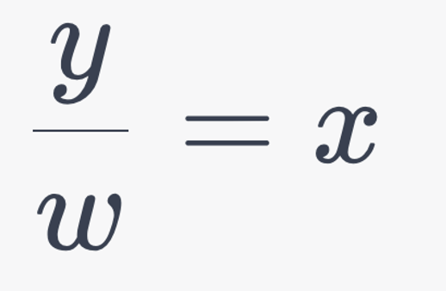
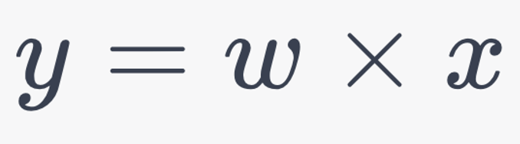
How would you do it

Slide 8
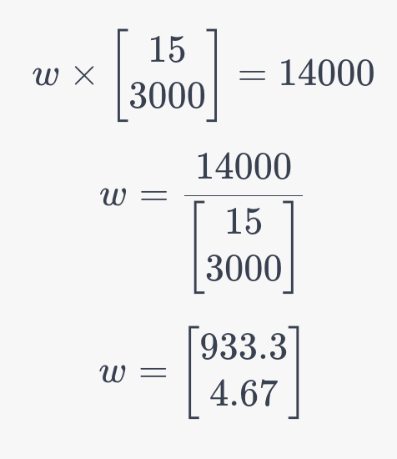
Trying it out!

Slide 9
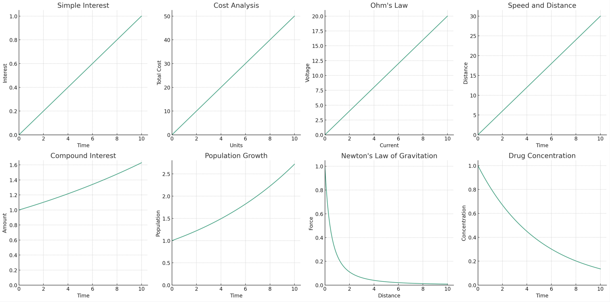
Linear vs Non-Linear Examples

Slide 10

How is it limited?
Line
Curve

Slide 11
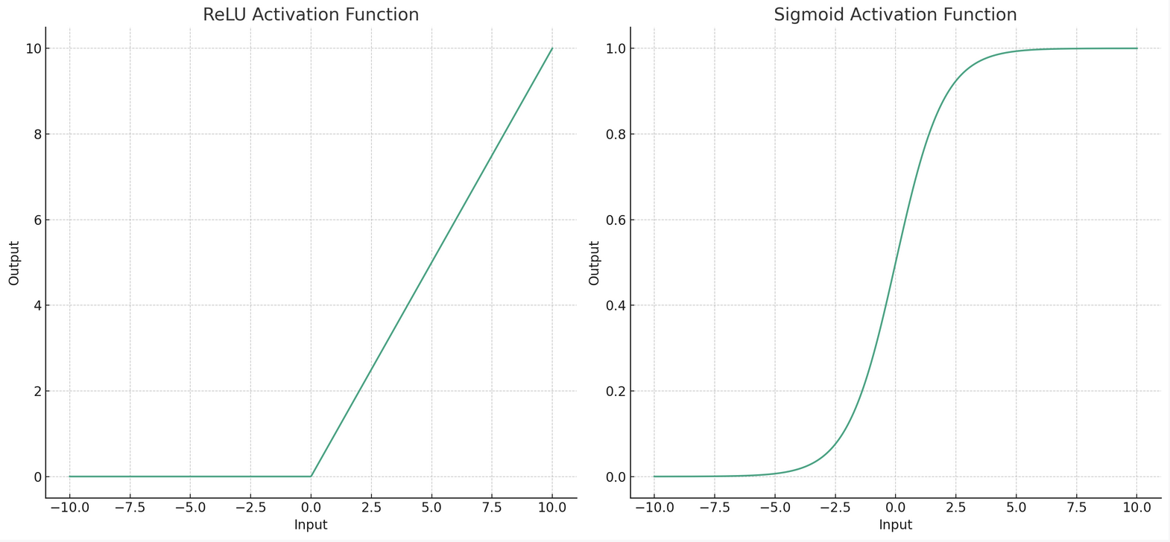
Using non-linear function

Slide 12
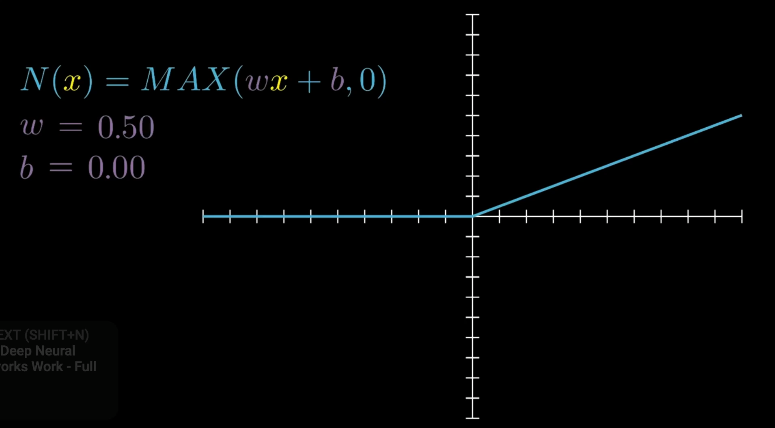
Animation of ReLU
Src: https://www.youtube.com/watch?v=0QczhVg5HaI

Slide 13
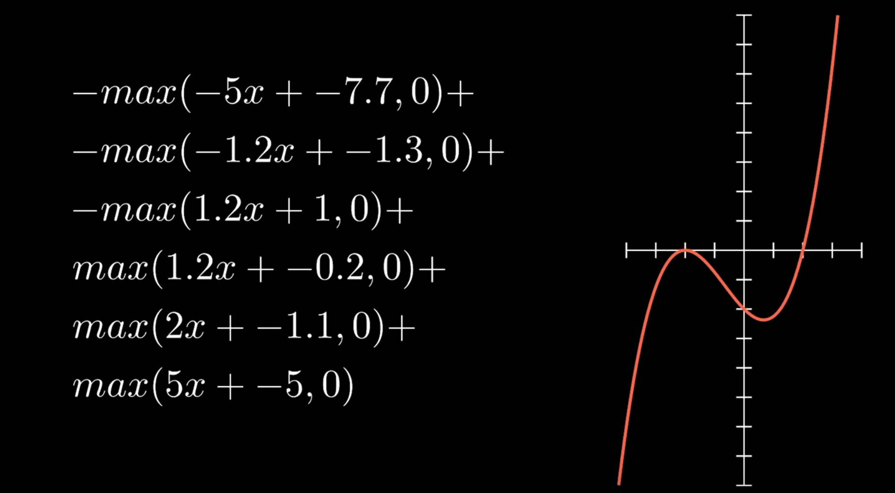
Animation of nonlinear function
Src: https://www.youtube.com/watch?v=0QczhVg5HaI

Slide 14
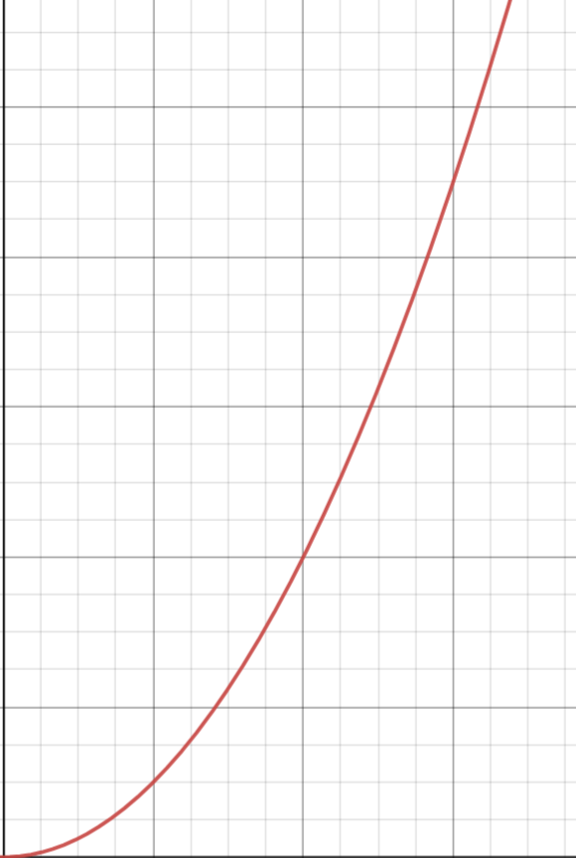
Comparing the two
Using Linear
Using Non-Linear

Slide 15
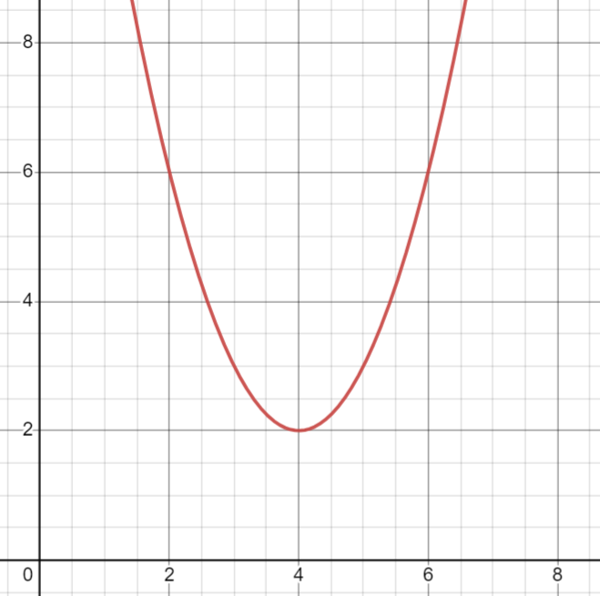
Finding Minimum of Error
Error
Value of Weights

Slide 16
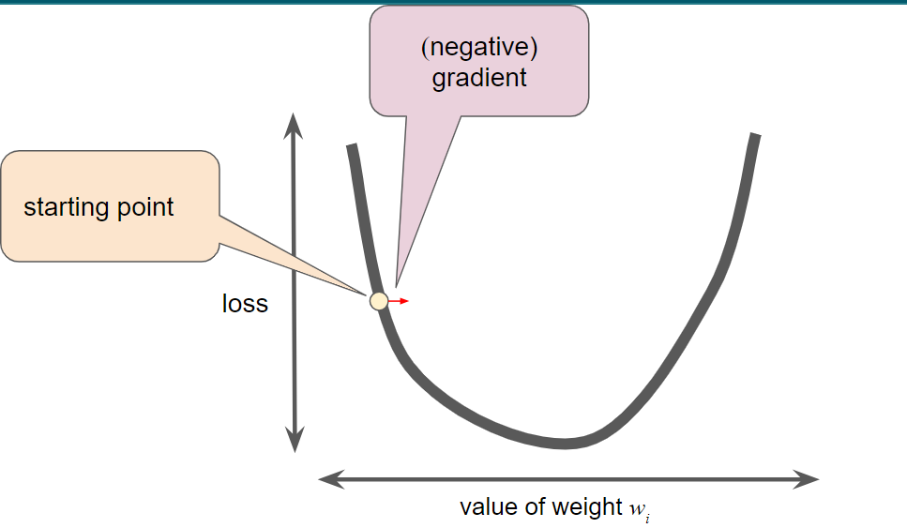
Why is slope’s direction useful?

Slide 17
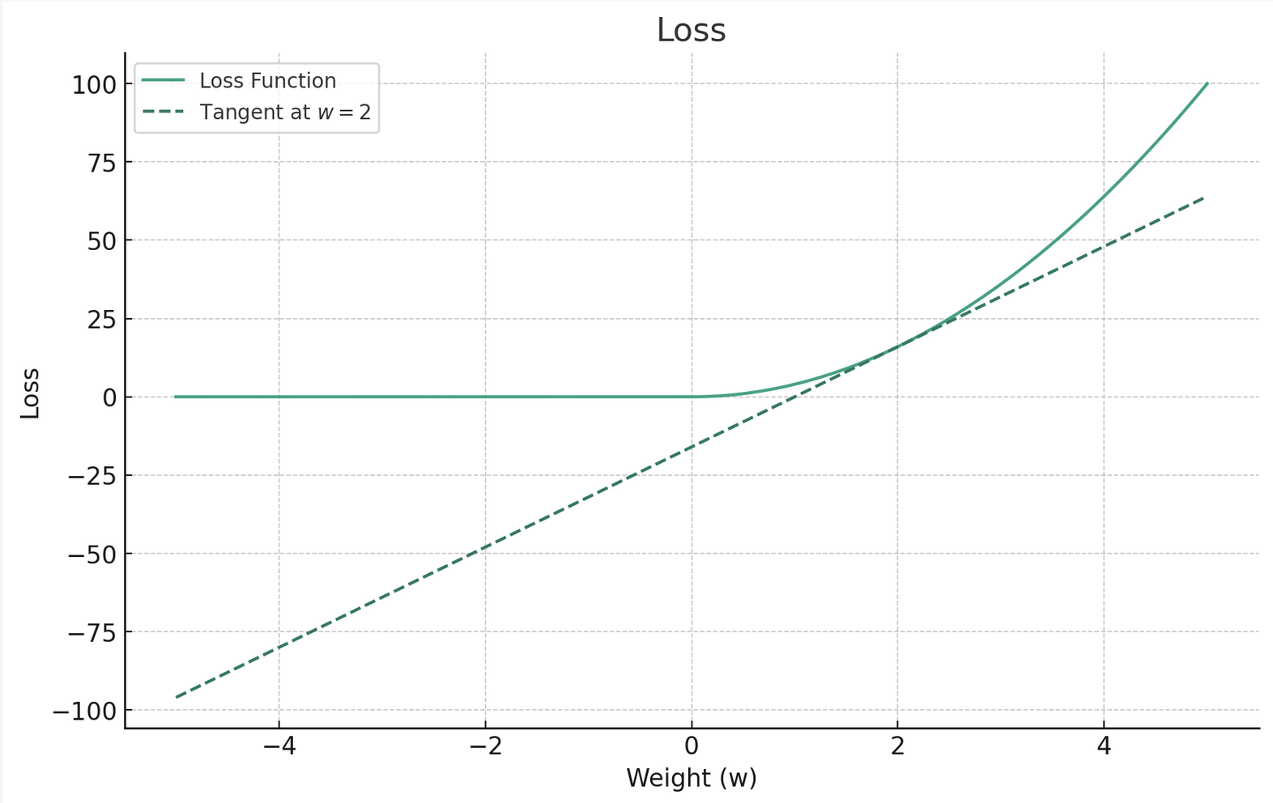
The Loss

Slide 18
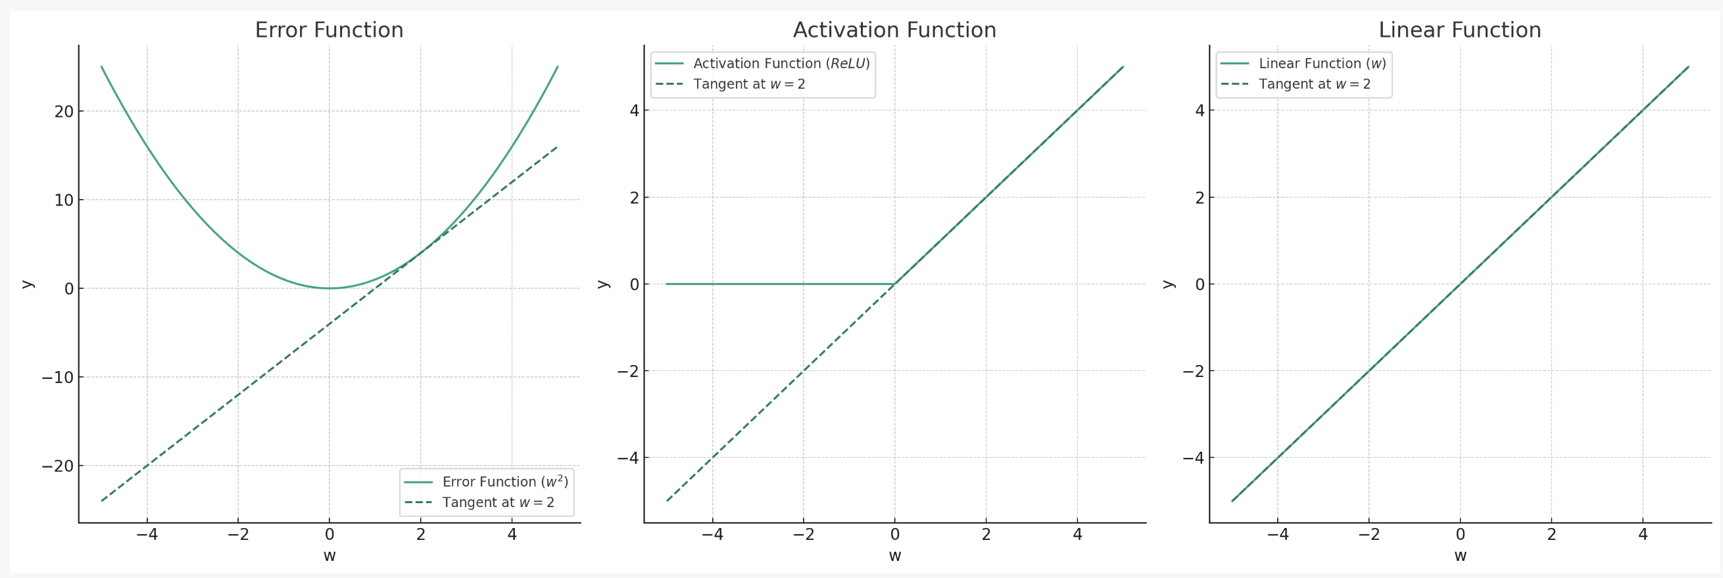
Breaking it Apart

Slide 19
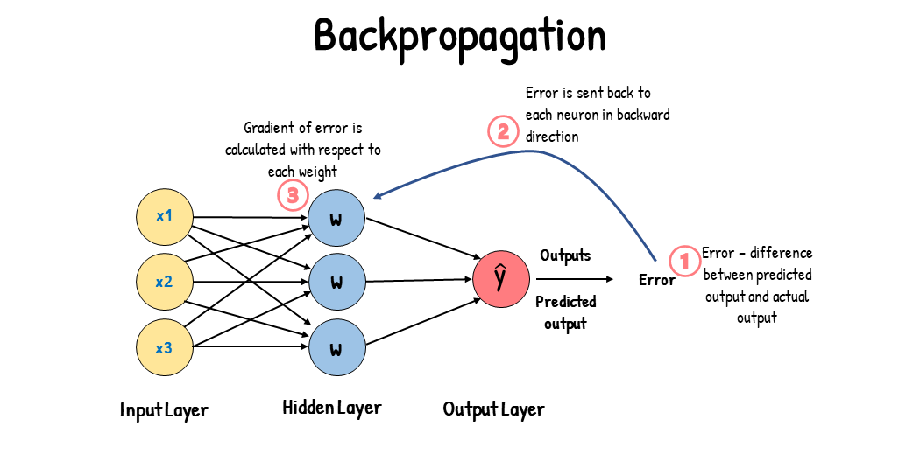
This is called backpropgration

Slide 20
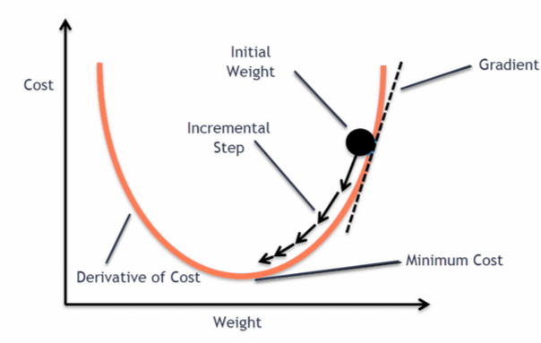
Using slopes to adjust weights
Slope
Error
Error

Slide 21
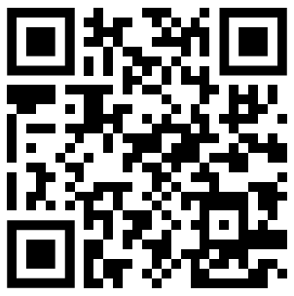
Sign In
SIGN IN CODE: 1959

Slide 22
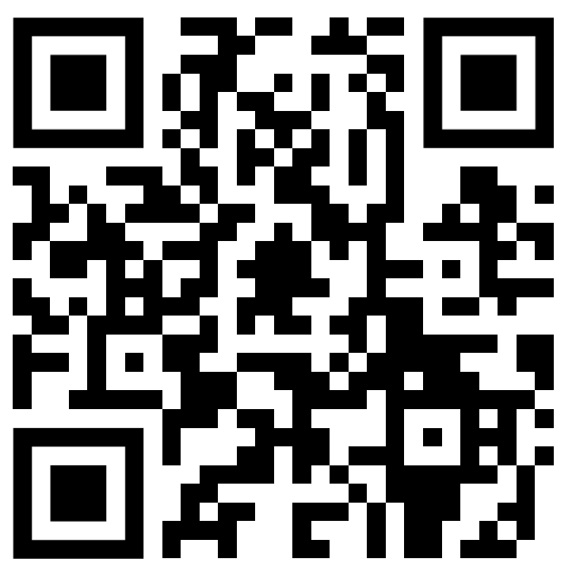
Workshop Time!!
Feedback Form
https://forms.gle/9Za1AmBCDuqwpSZn6

